Slide 1
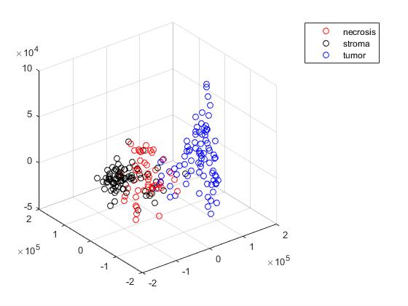
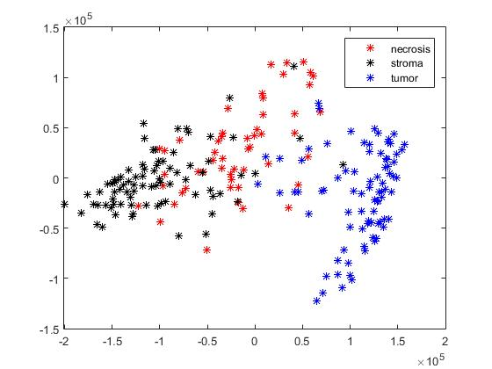
Results
SD Followed by PCNA
Scatter Plots of Dataset1(Supervised)

